Slide 1
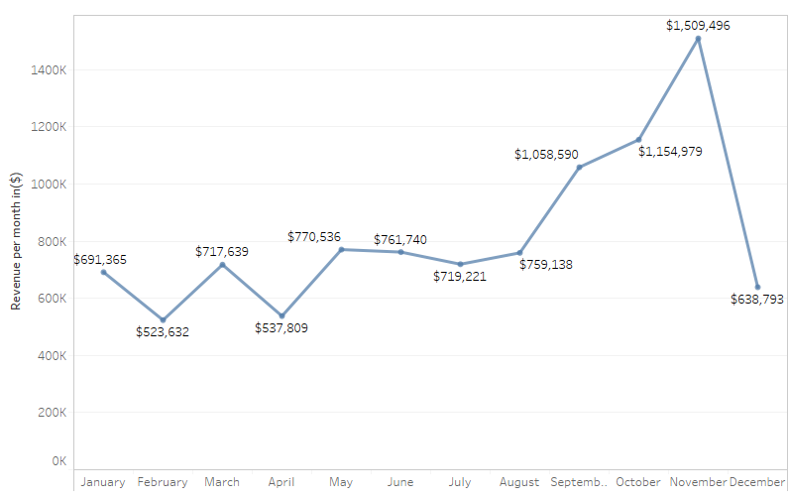
Revenue by each Month(2011)

Slide 2
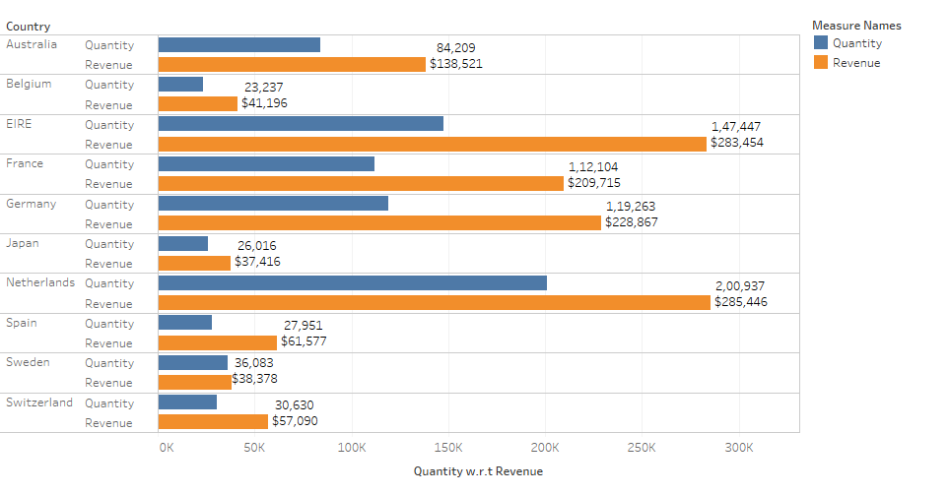
Revenue w.r.t Quantity (Top 10 Countries)

Slide 3
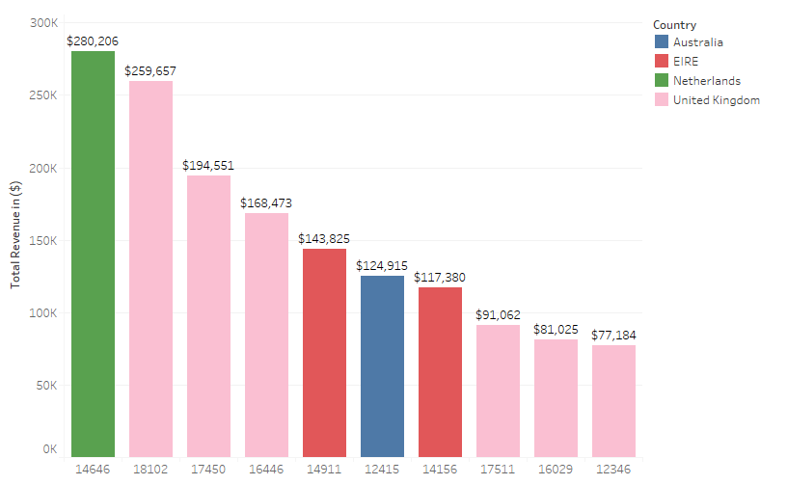
Top 10 Customers

Slide 4
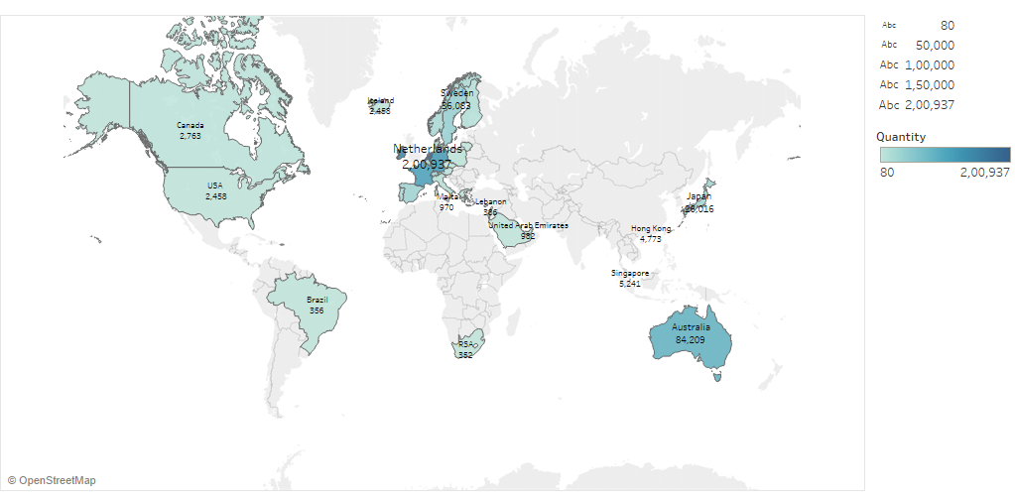
Quantity by each Country

